Slide 1
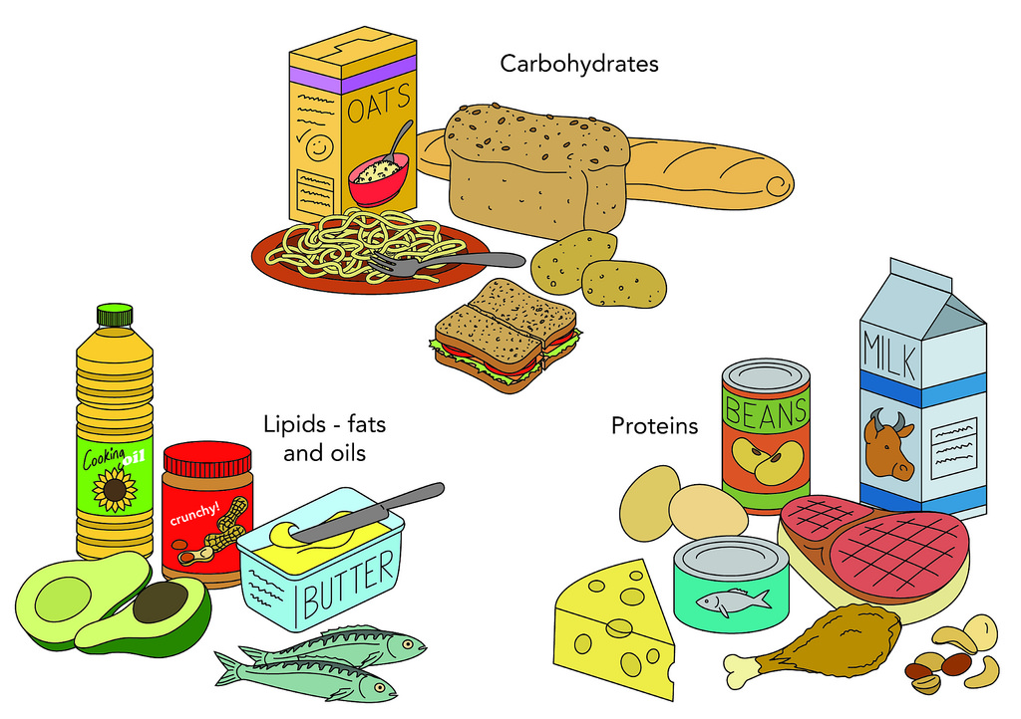
There’s DNA in my food!?

Slide 2
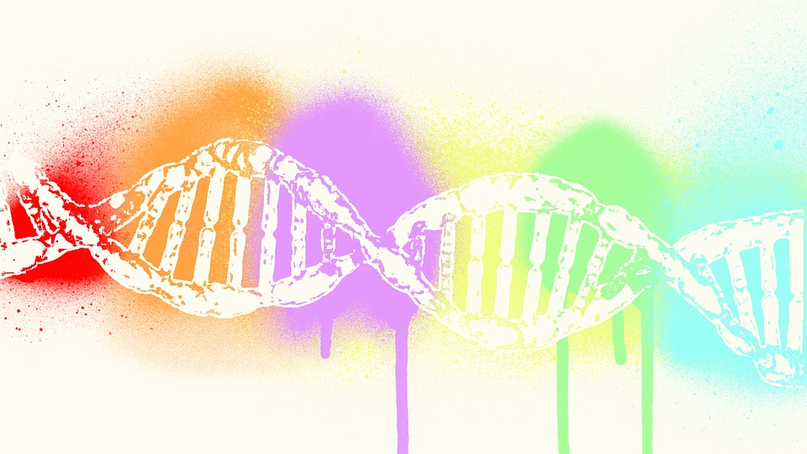
How Much Do You Know About DNA?
True or False?

Slide 3


DNA stands for Deoxyribonucleic Acid
TRUE
FALSE

Slide 4
CORRECT!
DNA does stands for Deoxyribonucleic Acid

Slide 5
Incorrect! ☹
DNA does stands for Deoxyribonucleic Acid!

Slide 6
Every living thing has DNA
TRUE
FALSE

Slide 7
CORRECT!
Every living thing does have DNA!

Slide 8
Incorrect! ☹
Every living thing does have DNA!

Slide 9
There is DNA in diamonds
TRUE
FALSE

Slide 10
CORRECT!
Diamonds do not contain DNA

Slide 11
Incorrect! ☹
Diamonds do not contain DNA

Slide 12
When stretched out the DNA in ONE of your cells is only ONE foot long
TRUE
FALSE

Slide 13
CORRECT!
When stretched out the DNA in ONE of your cells is about SIX foot long

Slide 14
Incorrect! ☹
When stretched out the DNA in ONE of your cells is about SIX foot long

Slide 15
DNA is condensed into structures called chromosomes
TRUE
FALSE

Slide 16
CORRECT!
DNA is condensed into structures called chromosomes!

Slide 17
Incorrect! ☹
DNA is condensed into structures called chromosomes!

Slide 18
DNA is located in the nucleus of cells
TRUE
FALSE

Slide 19
CORRECT!
DNA is located in the nucleus of cells!

Slide 20
Incorrect! ☹
DNA is located in the nucleus of cells!

Slide 21
There are 46 chromosomes in each human cell
TRUE
FALSE

Slide 22
TRICK QUESTION! ☺
There are 46 chromosomes in each human cell
EXCEPT
red blood cells which do not have any chromosomes

Slide 23
But Just in case you didn’t know…

Slide 24


Slide 25
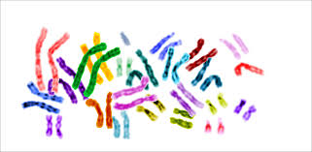
What About Ploidy?

Slide 27
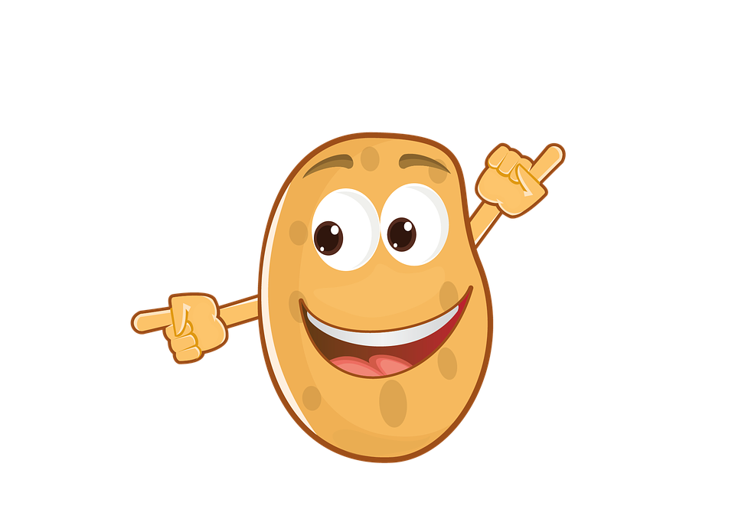
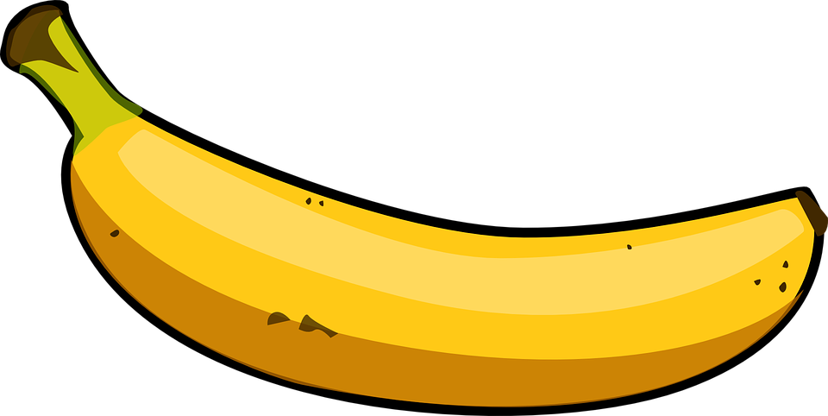
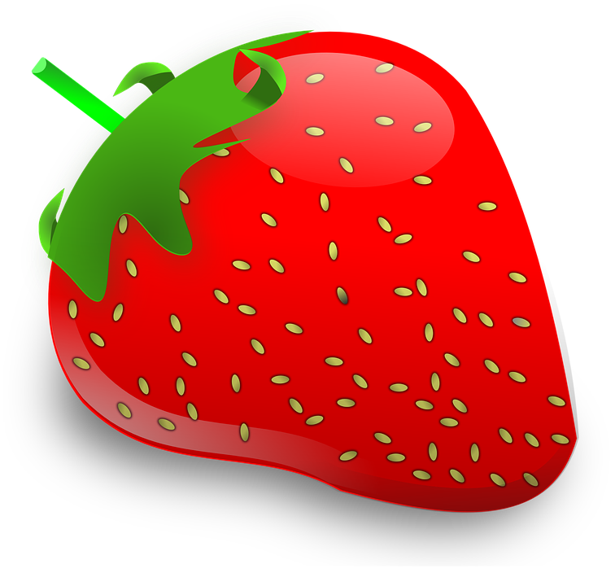
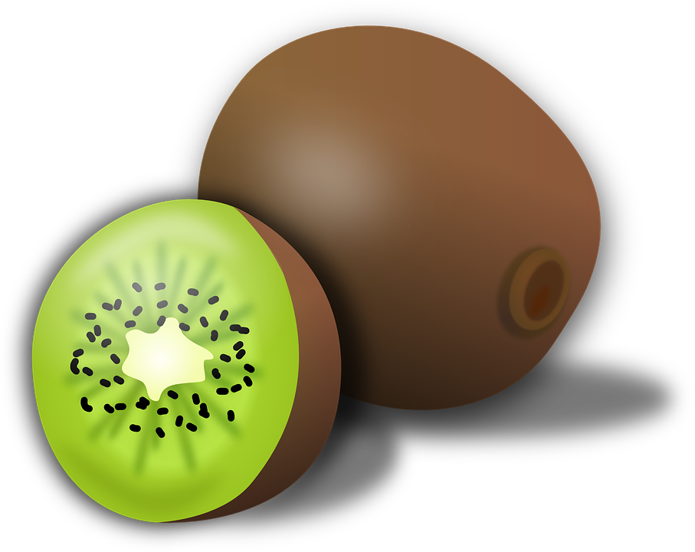
So what would be best for DNA Extraction?
Triploid
banana
Tetraploid
potato
Hexaploid
kiwi
Octoploid
Strawberry

Slide 28
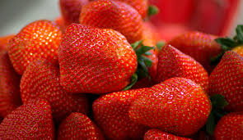
Extracting DNA from
Strawberries

Slide 29
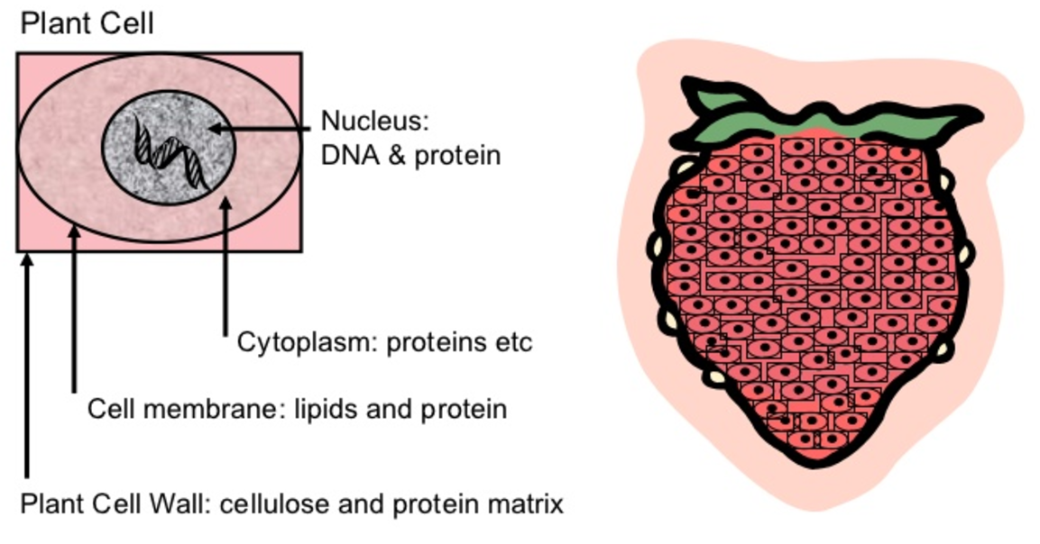

Slide 30
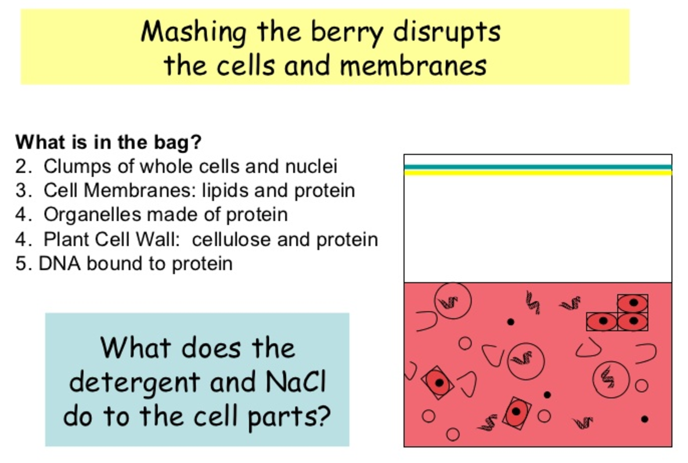

Slide 31
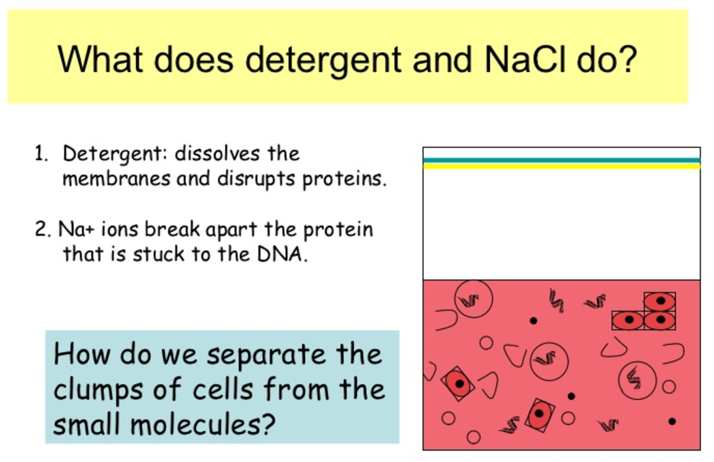
What does the soap and salt do???

Slide 32
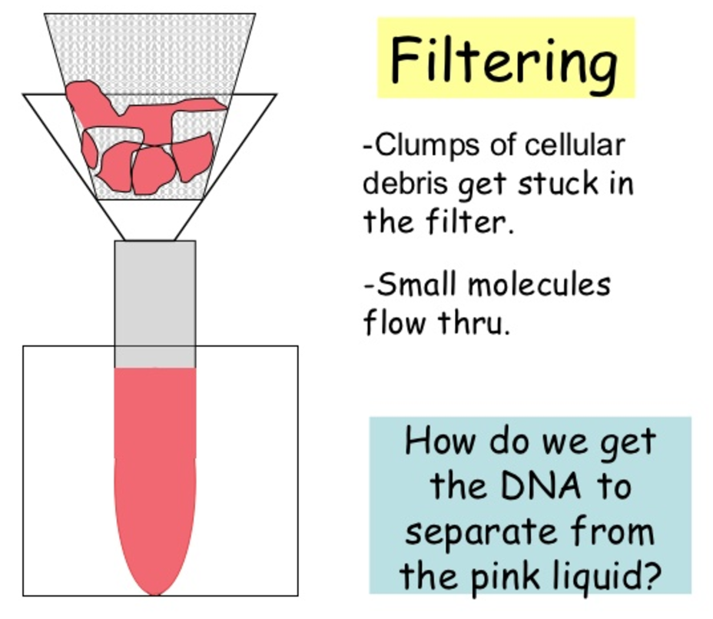

Slide 33
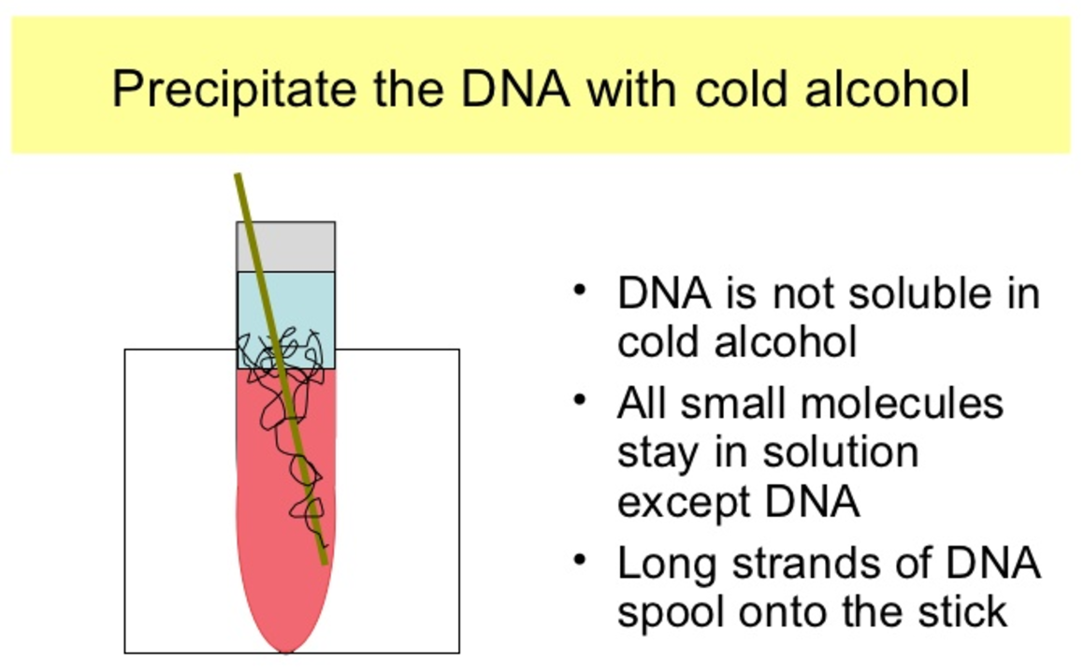

Slide 34
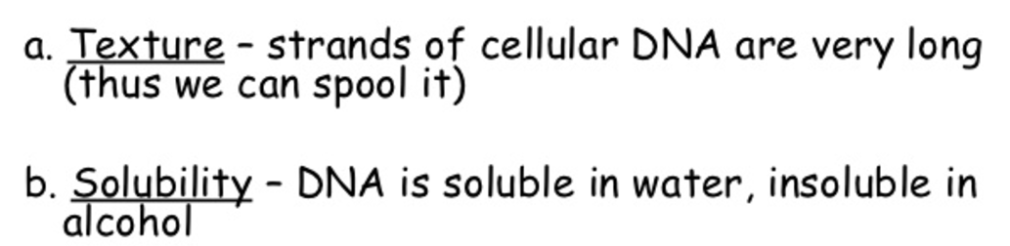
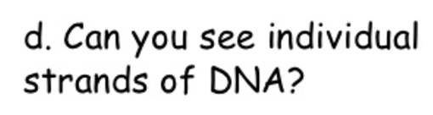
c. Why are there two layers when we add the alcohol?

